Slide 1



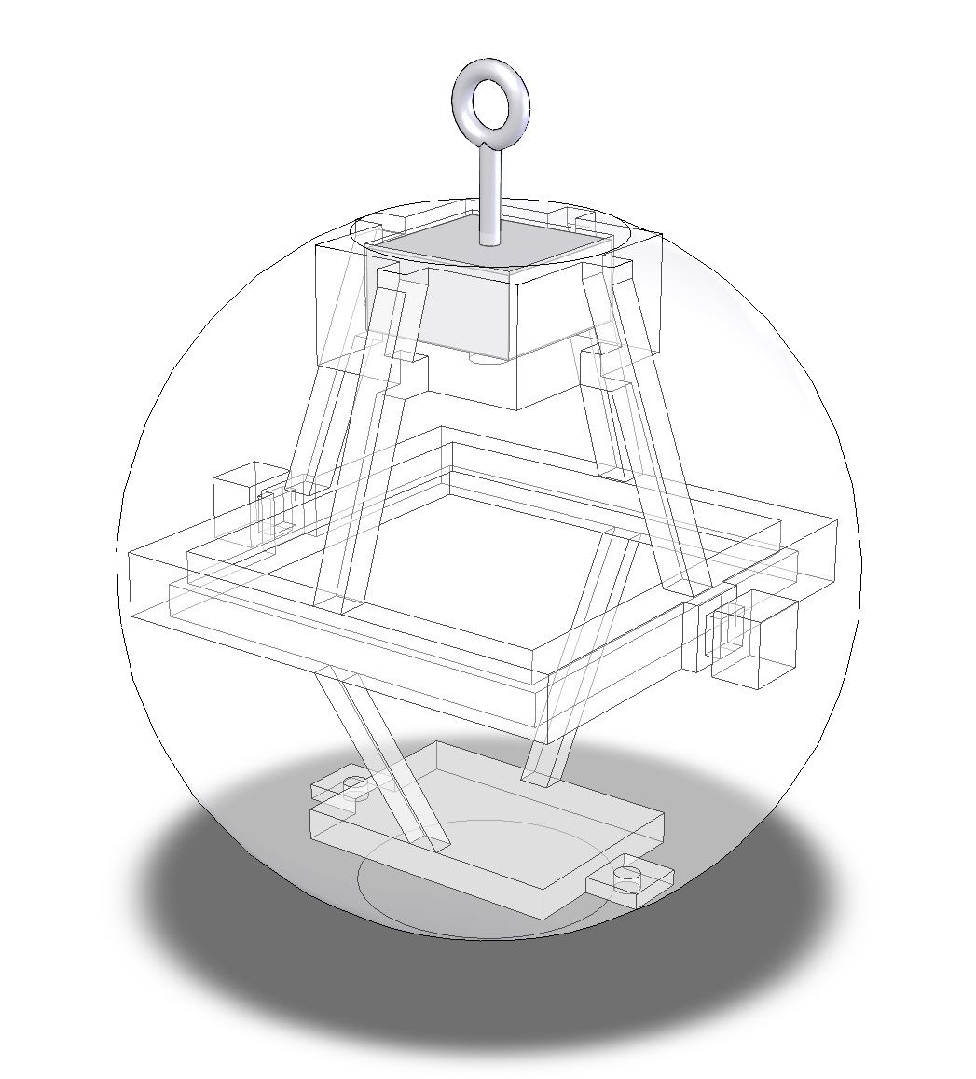
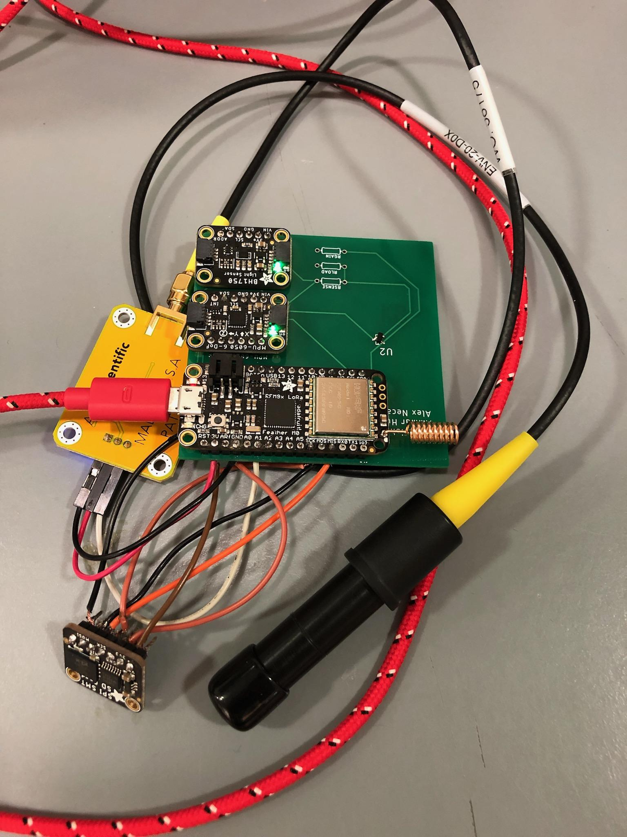
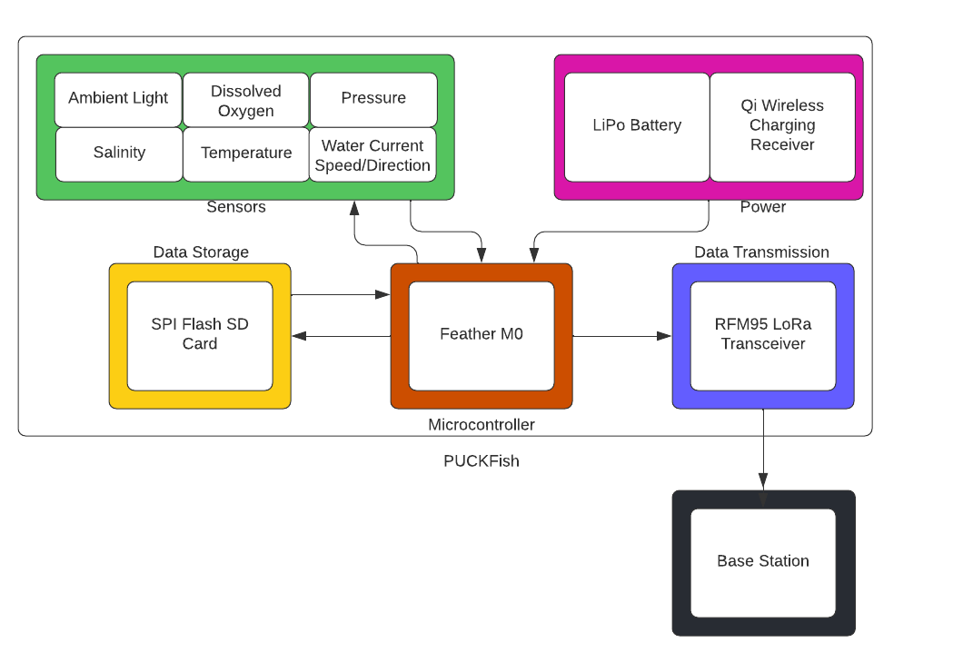
William Aracri, Peter Ha, Ammar Hussain, Alex Necakov, Victoria Thomas
Electrical and Computer Engineering Department, Boston University, Boston, Massachusetts 02215
Executive Summary
Device Design
Environmental Impact
The lobster fishing industry has largely remained unchanged since its emergence in the mid 1800s. The primary strategy for lobster fishing has also remained unchanged since the mid 1800s, where fishermen place traps upon habitual routes with no promise of a good catch yield This strategy leads fishermen to place extraneous traps throughout the ocean in areas unlikely to house lobsters. These extraneous traps have a significant environmental impact on other marine life such as the endangered North American Right Whale. The whales become caught in the lines of lobster traps and then perish, making “line entanglement” the leading cause of unnatural death among this population. Due to these environmental concerns, fishermen are limited by law in the number of traps they can place.
PUCKFish solves this by providing low-cost, rugged instrumentation to fisheries. This device puts the tools for data acquisition and analysis in the hands of trappers providing information to inform data-backed decisions about where to place lobster traps and optimizing fishing hauls. We will be producing three PUCKFish data collection devices each of which records six key metrics relevant to lobster activity on the seafloor. PUCKFish will be the first business-grade, all-in-one data collection and analysis suite specifically for lobster fishermen. Its low cost and ability to collect metrics most critical to locating and tracking lobsters will revolutionize the lobster fishing industry.
Table 1: Project Costs for Production of Beta Version (Next Unit after Prototype)
Item | Quantity | Description | Unit Cost | Extended Cost
Epoxy Resin and Hardener | 0.183 Gal | Two part epoxy mixture, of a 1.5 Gal kit | $172.78 | $21.08
3D Printed Skeleton | 1 | Skeleton mount for PCB, sensors, eyebolt mount | $10 | $10
Eyebolt | 1 | Eyebolt for tying to trap | $1.50 | $1.50
Aluminum Eyebolt Mount | 1 | Aluminum block for skeleton mount, drilled and threaded for eyebolt | $15 | $15
PCB | 1 |  | $4.60 | $4.60
Dissolved O2 Sensor | 1 |  | $152.99 | $152.99
Light Sensor | 1 |  | $1.06 | $1.06
IMU | 1 |  | $7.78 | $7.78
Salinity Sensor | 1 |  | $0.90 | $0.90
Temperature and Pressure Sensor | 1 |  | $30 | $30
Beta Version-Total Cost |  |  |  | $244.91
Figure 1: Skeleton and Mold Model
Figure 2: PCB with Sensors
Each PUCKFish device comes pre-built with no assembly required. The device needs to be charged using a Qi wireless charging pad. The device must be attached to a lobster trap line with the eye-bolt with enough slack for it to drift about underwater. The PUCKFish should be fully charged before use and the exterior sensor ports must not be obstructed to ensure full data collection and recovery. Software will automatically run on the PUCKFish while it is powered on. Receiving data from the PUCKFish will require users to run Fathom Fishing’s base station software.
For the dissolved oxygen sensor, the galvanic probe requires periodic recalibration with an electrolyte solution. Over time, this solution will be depleted and will eventually need to be refilled. To refill the probe, enough of the probe needs to be exposed to allow for the cap to be removed to refill the solution. When filling the solution, the user must use a standard syringe to fill the cap to its brim with the solution. Once The solution is filled, the cap must be properly screwed back on to ensure no leakage and to prevent corrosion.
Conclusion
Sensor Requirements
Insert conclusion here
Temperature
Different marine species prefer different temperatures in relation to their body temperature to function optimally. Temperature can affect basic biological processes such as metabolism, reproduction, and growth.
Depth
Pressure differences affect the physiological structure of marine life. Fish or animals may be better suited to either higher or lower pressures depending on their role in the ecosystem.
Ambient Light
Marine plant life depends upon photosynthesis to produce energy. As plant life or algae are commonly the base of the ecosystem, different light amounts may point to more dense populations of plant life, and thus, other forms of marine life.
Dissolved Oxygen
Marine life extracts dissolved oxygen from water in order to maintain biological function. The amount of oxygen available in the water tends to increase proportionally with the availability of marine life
Current Speed and Direction
Current speed and direction can show migration patterns as well as still spots where habitats can form without the force of the current moving them around.
Salinity
Salinity affects marine life, as they typically have optimal ranges in which they prefer to reside. The biological effects of salt impact functions like osmosis and metabolic processes which are key processes that sustain life for aquatic life.
Figure3: System Block Diagram
Future Direction
Insert future direction here
Acknowledgments
We would like to thank our customers, Andy Whitman and Anthony Byrne at Fathom Fishing. Additionally we would like to thank our ECE advisor team, principally Professor Osama Alshaykh and Professor Pisano.

